Slide 1
Convolutional Neural Network Tutorial
Part1
Sungjoon Choi
(sungjoon.choi@cpslab.snu.ac.kr)

Slide 2
Overview
Part1: TensorFlow Tutorials
Handling images
Logistic regression
Multi-layer perceptron
Convolutional neural network
Part2: Advances in convolutional neural networks
CNN basics
Four CNN architectures (AlexNet, VGG, GoogLeNet, ResNet)
Application1: Semantic segmentation
Application2: Object detection

Slide 3
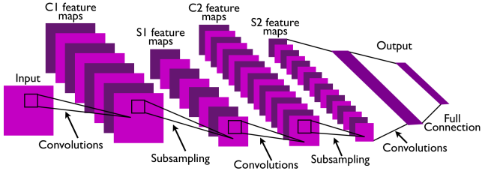
CNN
Convolutional Neural Network
CNNs are basically layers of convolutions followed by subsampling and dense layers.
Intuitively speaking, convolutions and subsampling layers works as feature extraction layers while a dense layer classifies which category current input belongs to using extracted features.

Slide 4
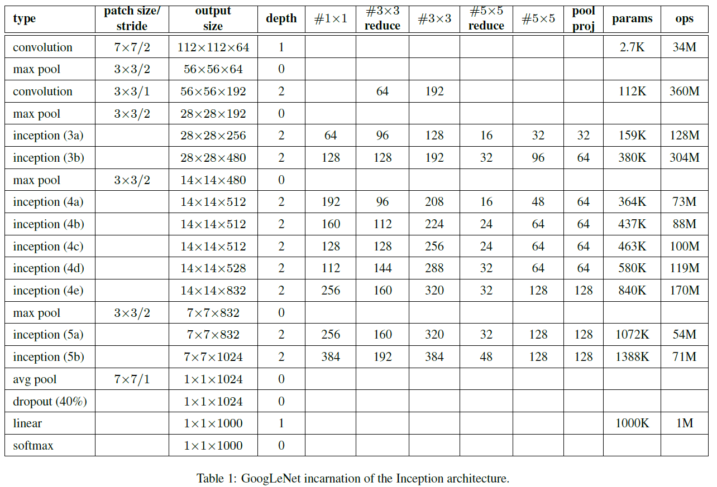

To understand CNN,
Zero-padding
Stride
Channel

Slide 5

Convolution
http://deeplearning.stanford.edu/wiki/index.php/Feature_extraction_using_convolution

Slide 6
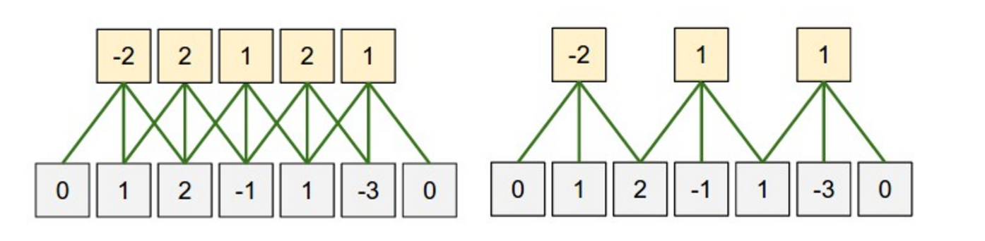
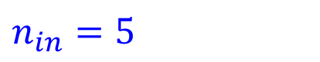
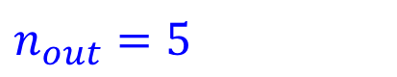
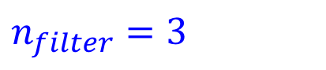
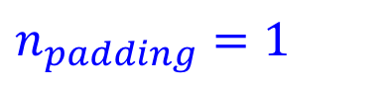
Zero-padding
What is the size of the input?
$n_{in}=5$
What is the size of the output?
$n_{out}=5$
What is the size of the filter?
$n_{filter}=3$
What is the size of the zero-padding?
$n_{padding}=1$

Slide 7
Stride
(Left) Stride size: 1
(Right) Stride size: 2
If stride size equals the filter size, there will be no overlapping.

Slide 8
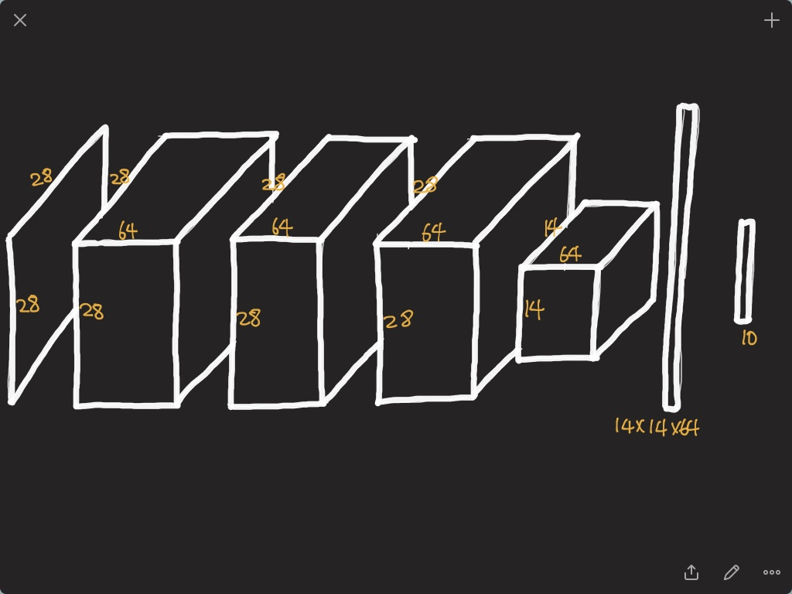

Slide 9
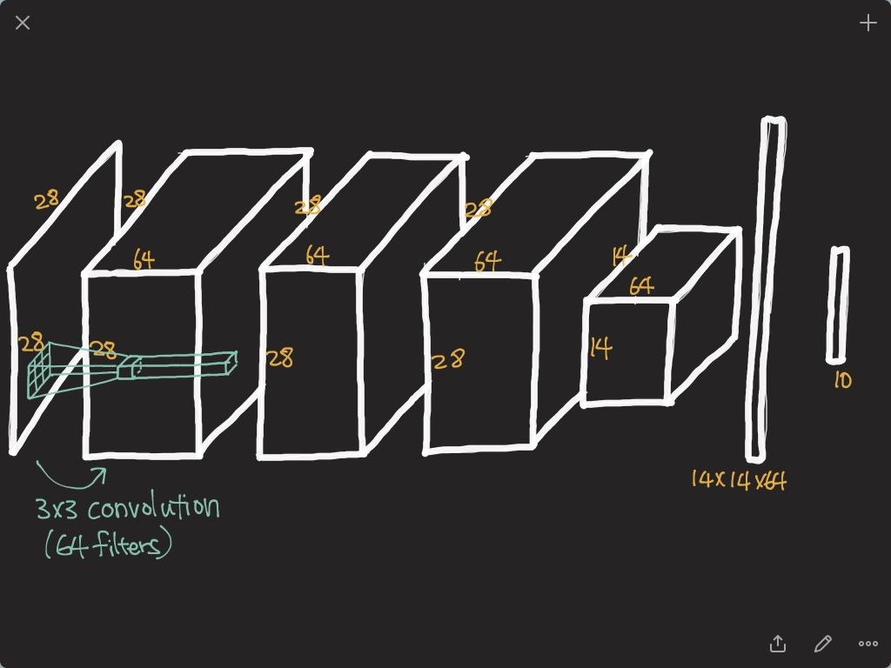

Slide 10
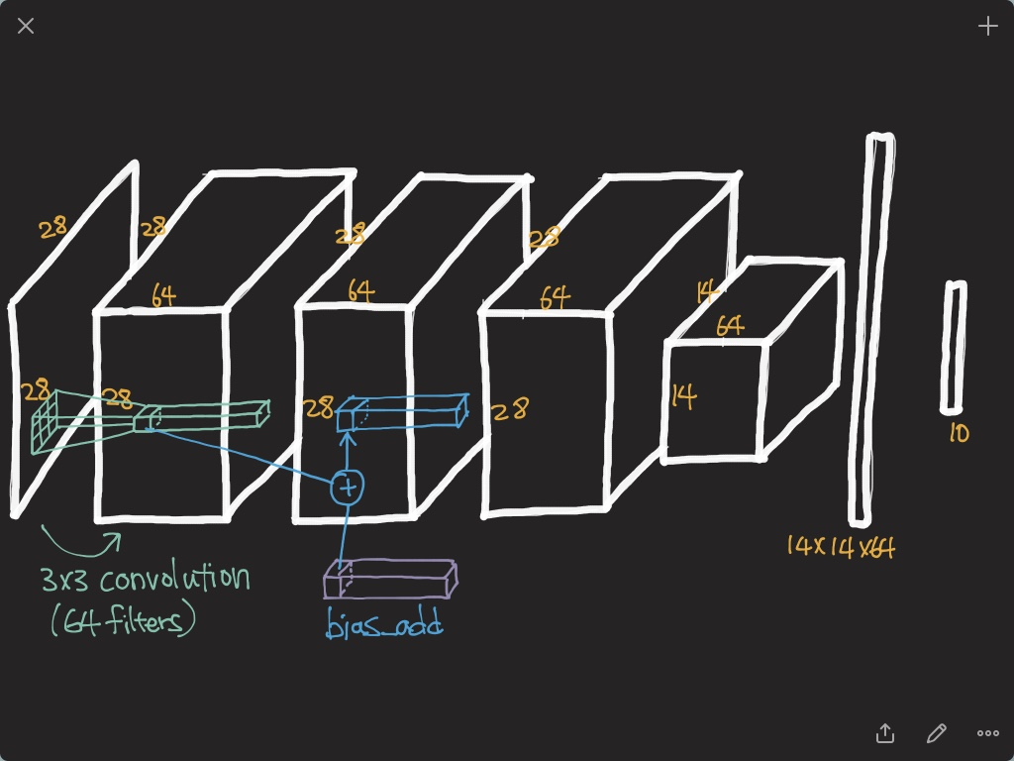

Slide 11
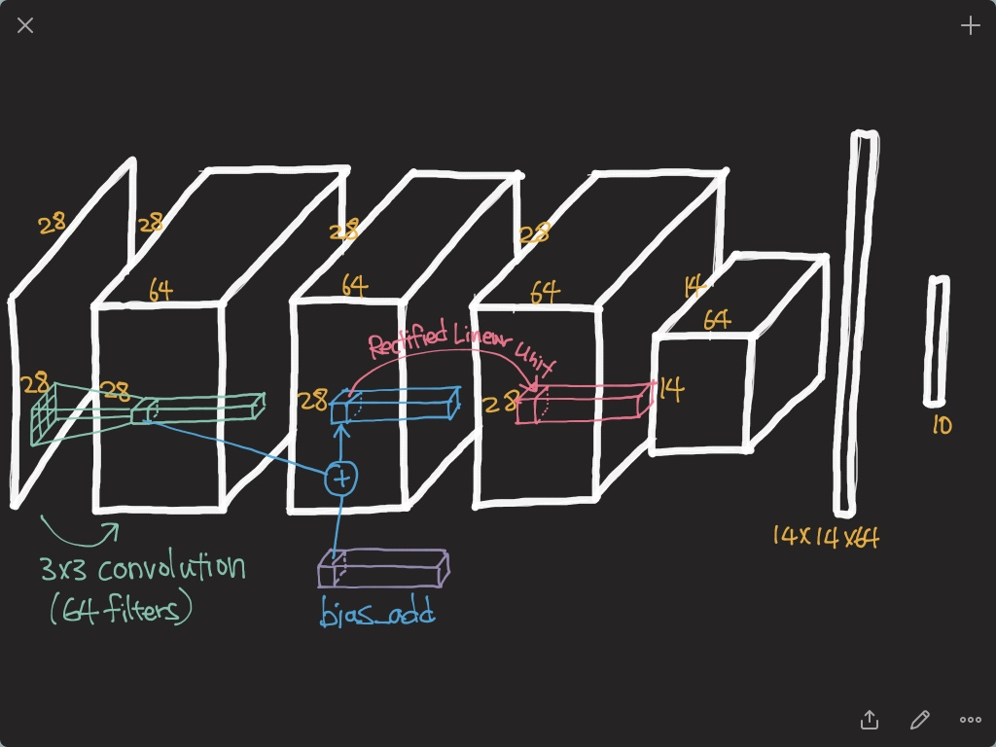

Slide 12
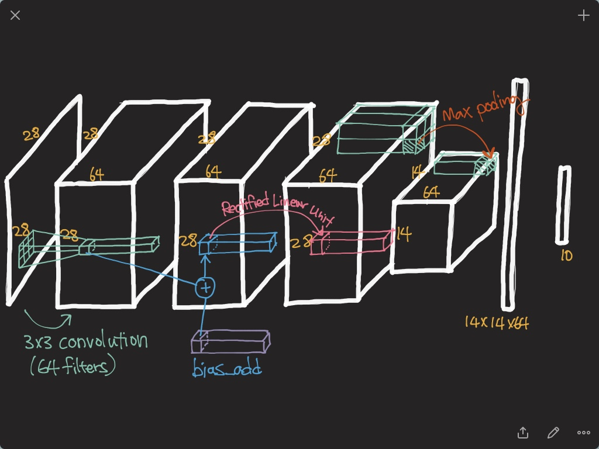

Slide 13
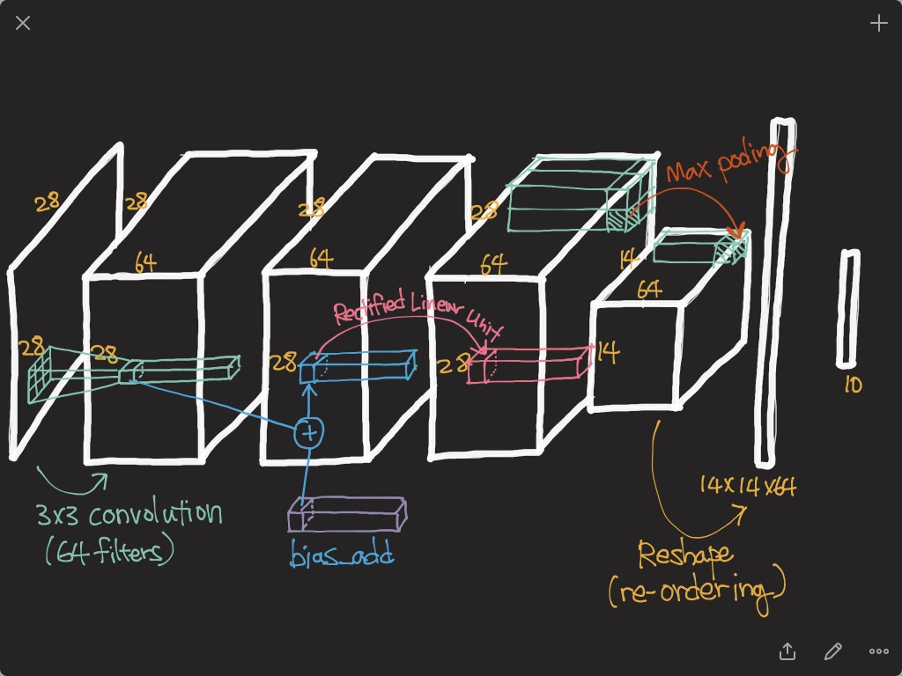

Slide 14
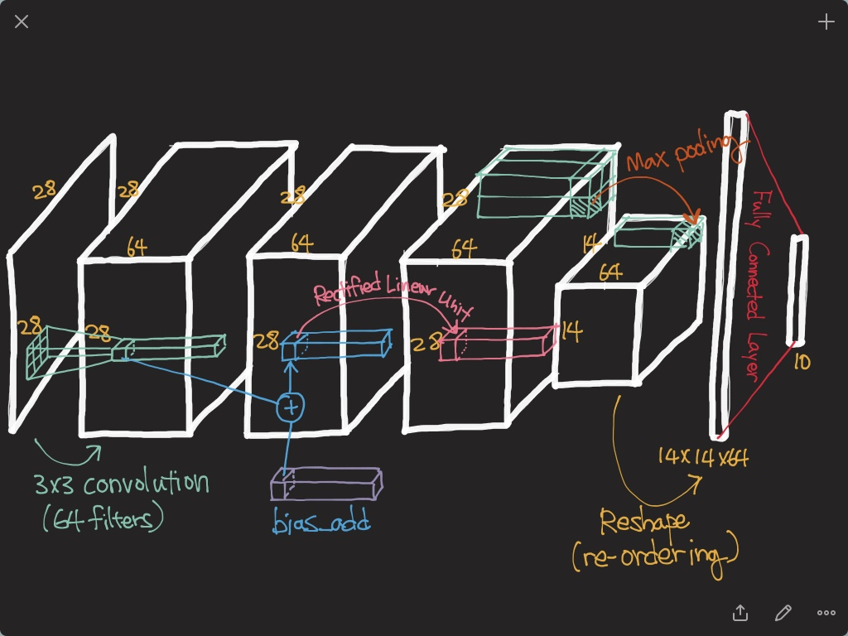

Slide 15
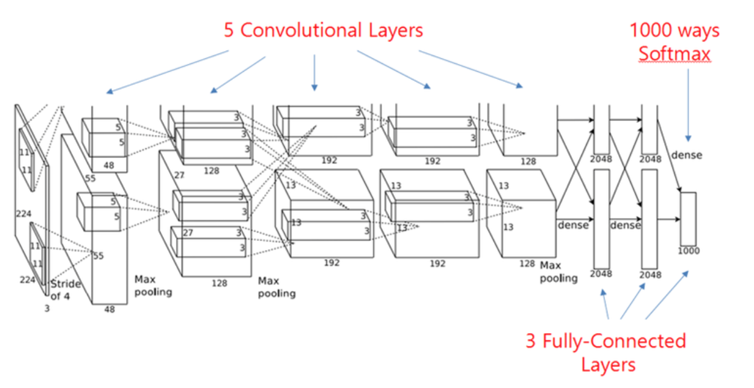
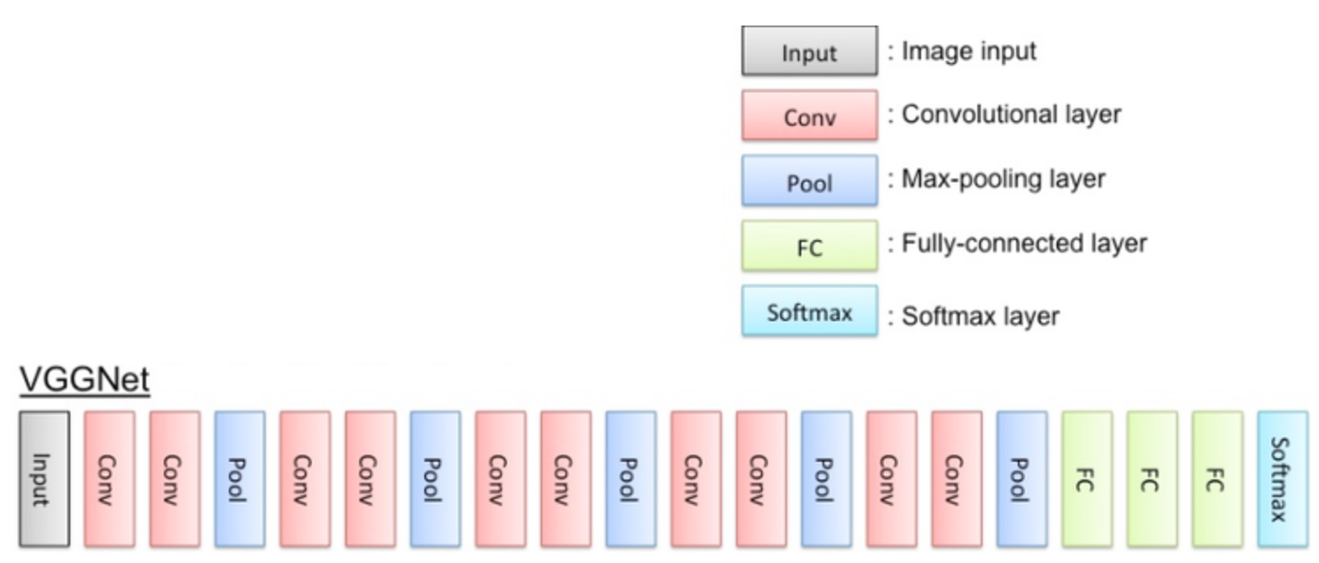
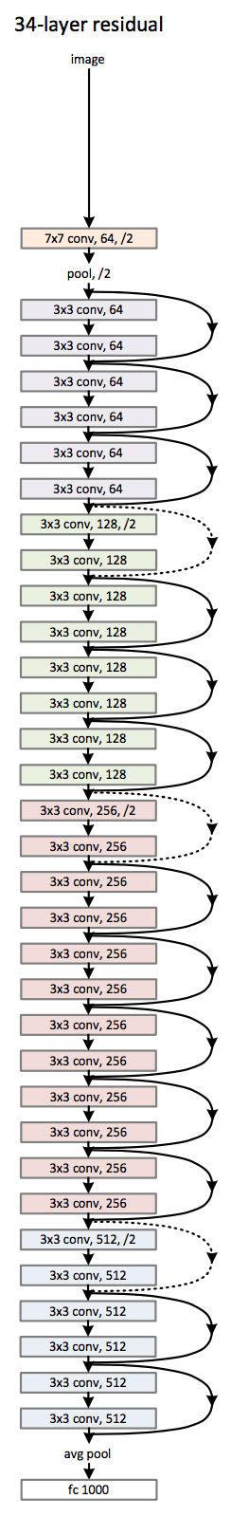
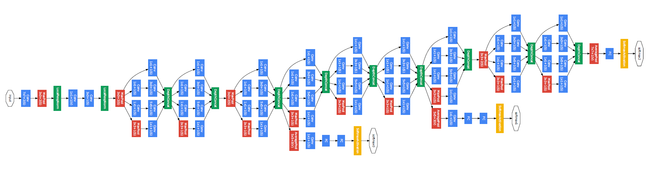
CNN Architectures
AlexNet
VGG
GoogLeNet
ResNet

Slide 16
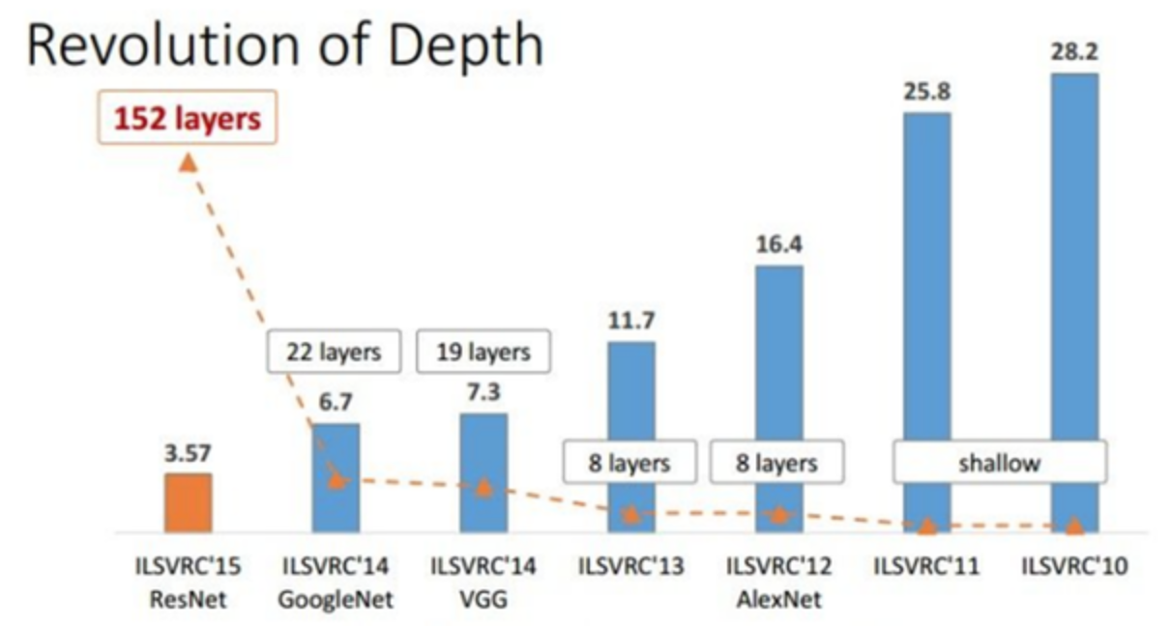
Top-5 Classification Error

Slide 17
AlexNet

Slide 18
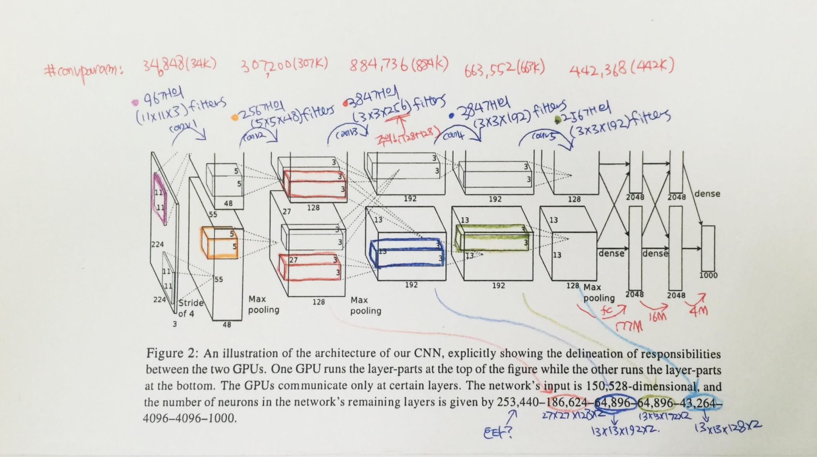
AlexNet

Slide 19
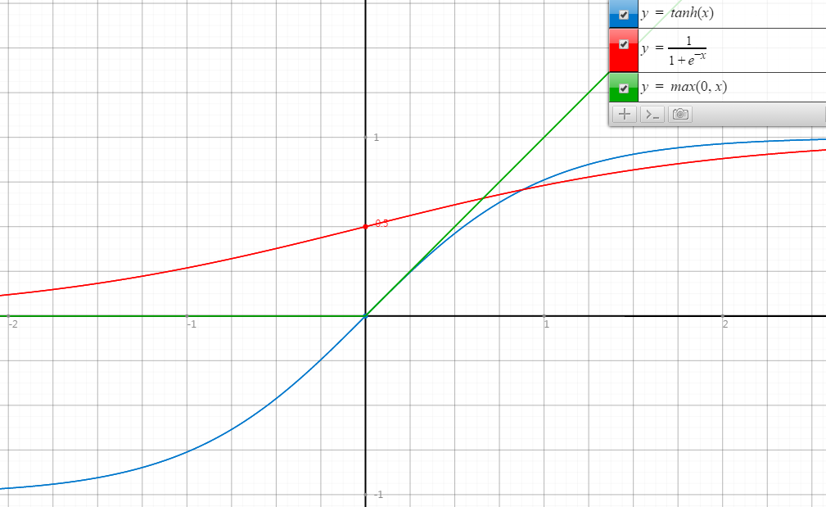
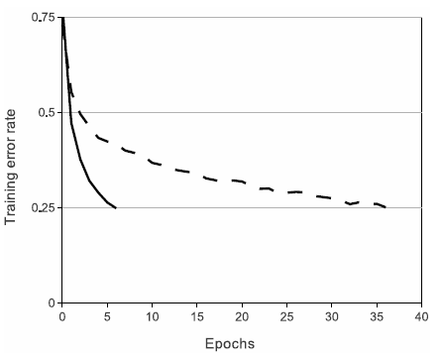
ReLU
Rectified Linear Unit
ReLU
tanh
Faster Convergence!

Slide 20
VGG

Slide 21
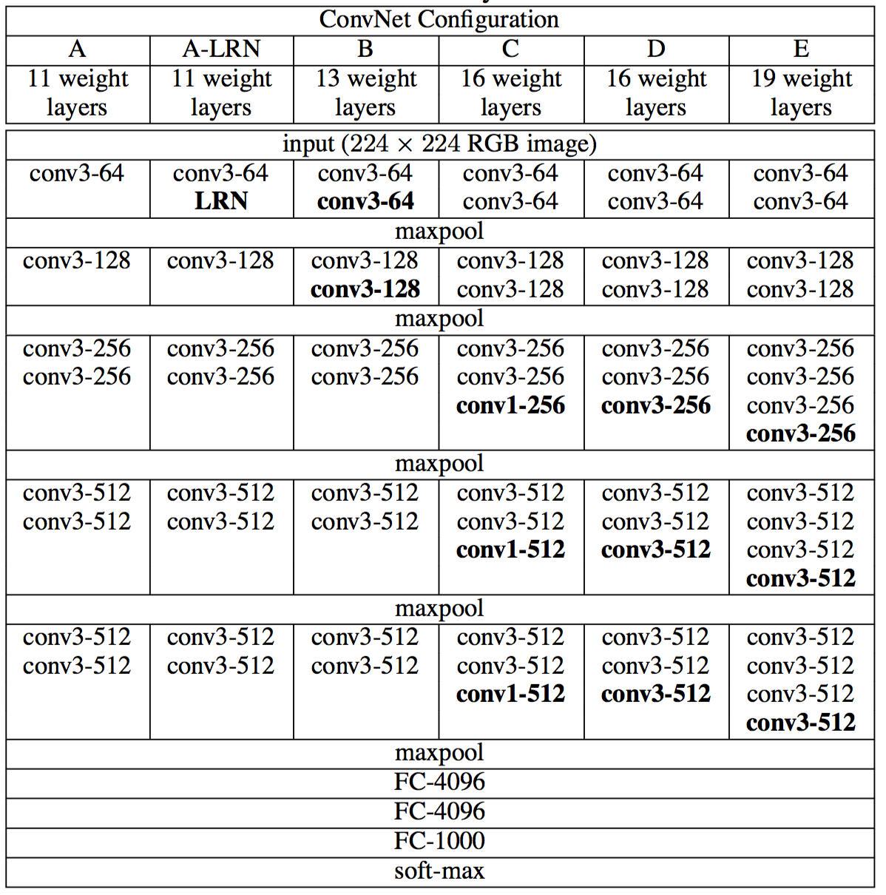
VGG?

Slide 22
GoogLeNet

Slide 23


GoogLeNet

Slide 24
GoogLeNet
22 Layers Deep Network
Efficiently utilized computing resources, “Inception Module”
Significantly outperforms previous methods on ILSVRC 2014

Slide 25
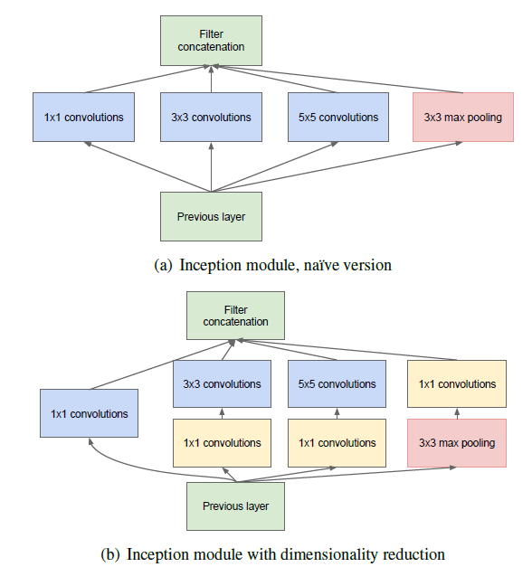
Inception module

Slide 26
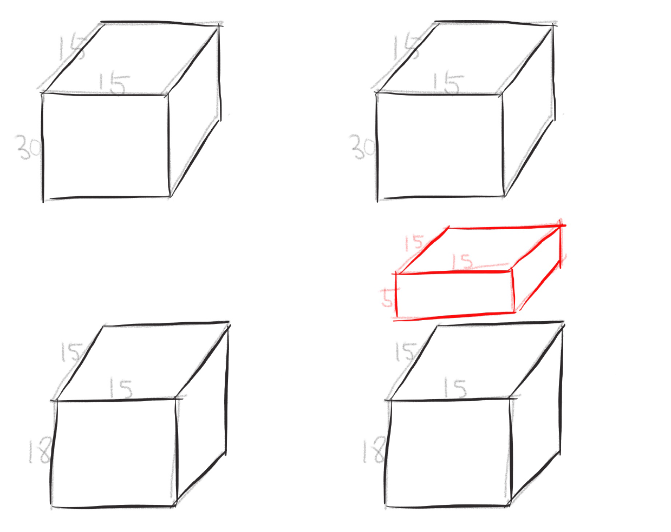
One by one convolution

Slide 27
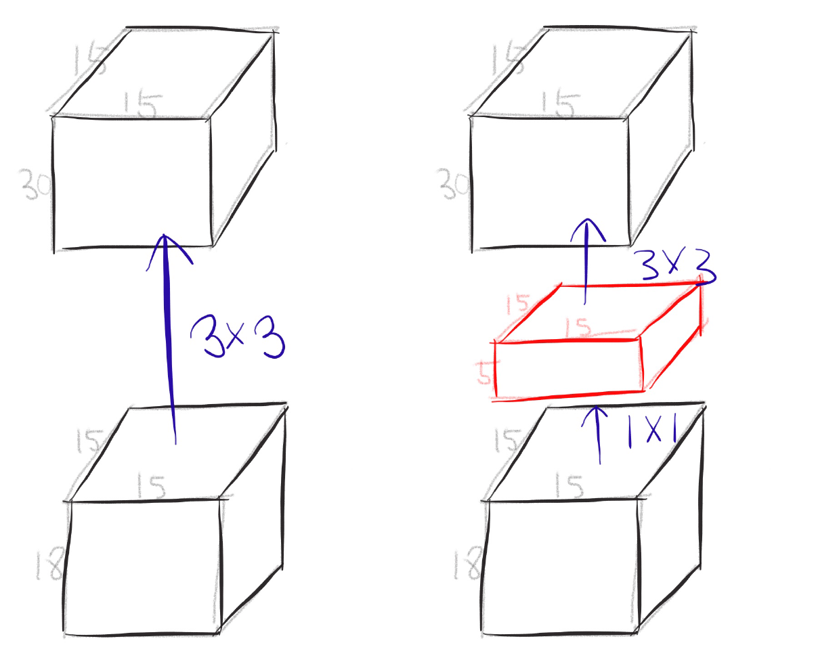
One by one convolution

Slide 28
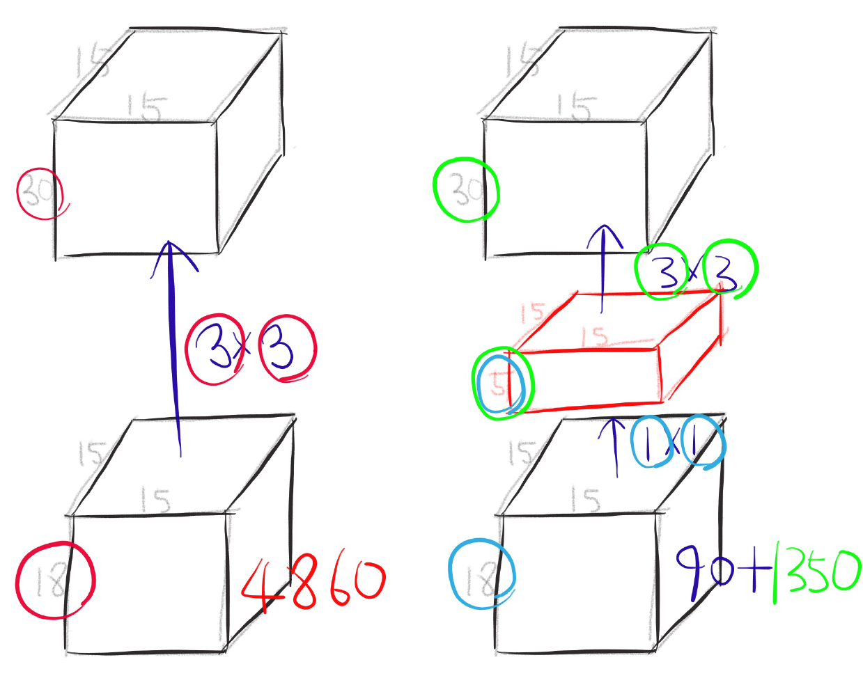
One by one convolution

Slide 29
GoogLeNet
Network in Network!

Slide 30
ResNet

Slide 31
Deep residual networks
152 layers network
1st place on ILSVRM 2015 classification task
1st place on ImageNet detection
1st place on ImageNet localization
1st place on COCO detection
1st place on COCO segmentation

Slide 32
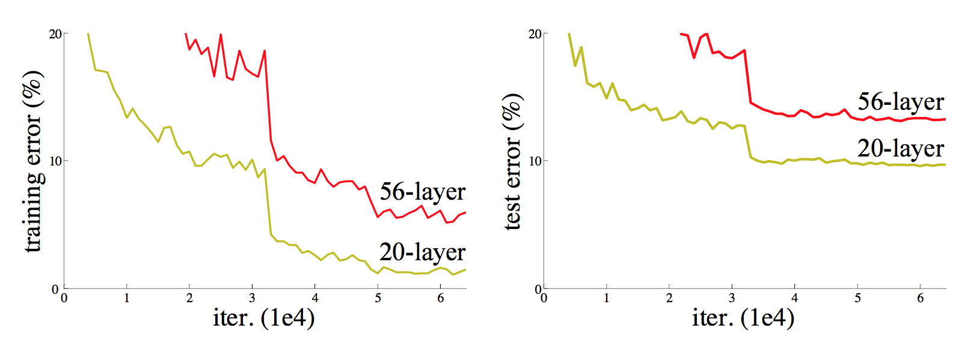
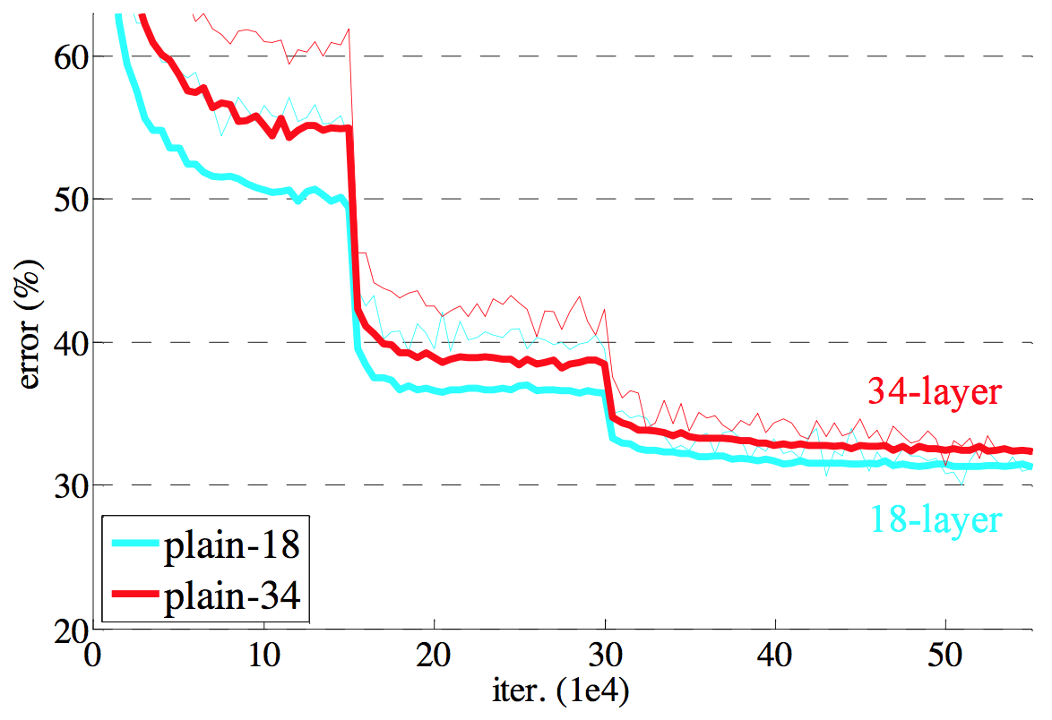
Degeneration problem
CiFAR 100 Dataset
ImageNet

Slide 33
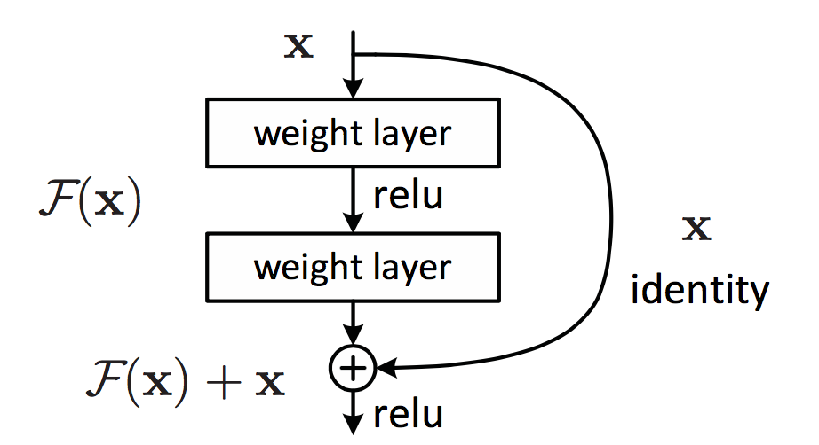
Residual learning building block

Slide 34
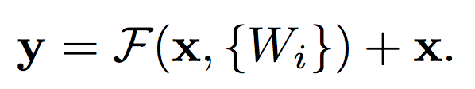
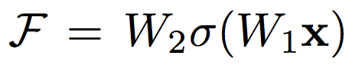
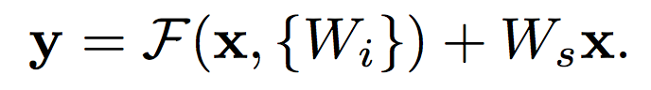
Residual mapping
Basic residual mapping (same dim.)
“But we will show by experiments that the identity mapping is sufficient for addressing the degradation problem and is economical, and thus W is only used when matching dimensions.”
Basic residual mapping (different dim.)

Slide 35
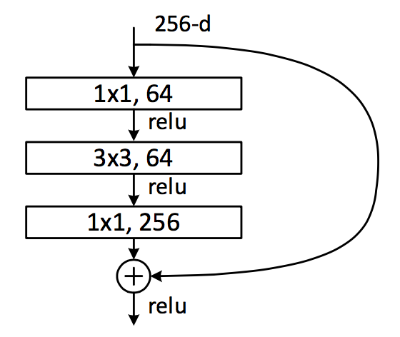
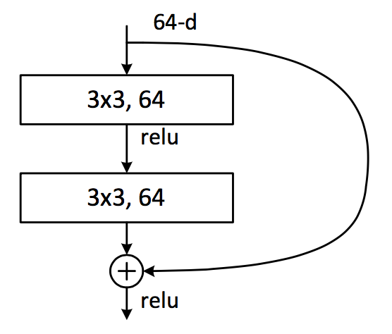
Deeper bottle architecture
Dimension reduction
Convolution
Dimension increasement

Slide 36
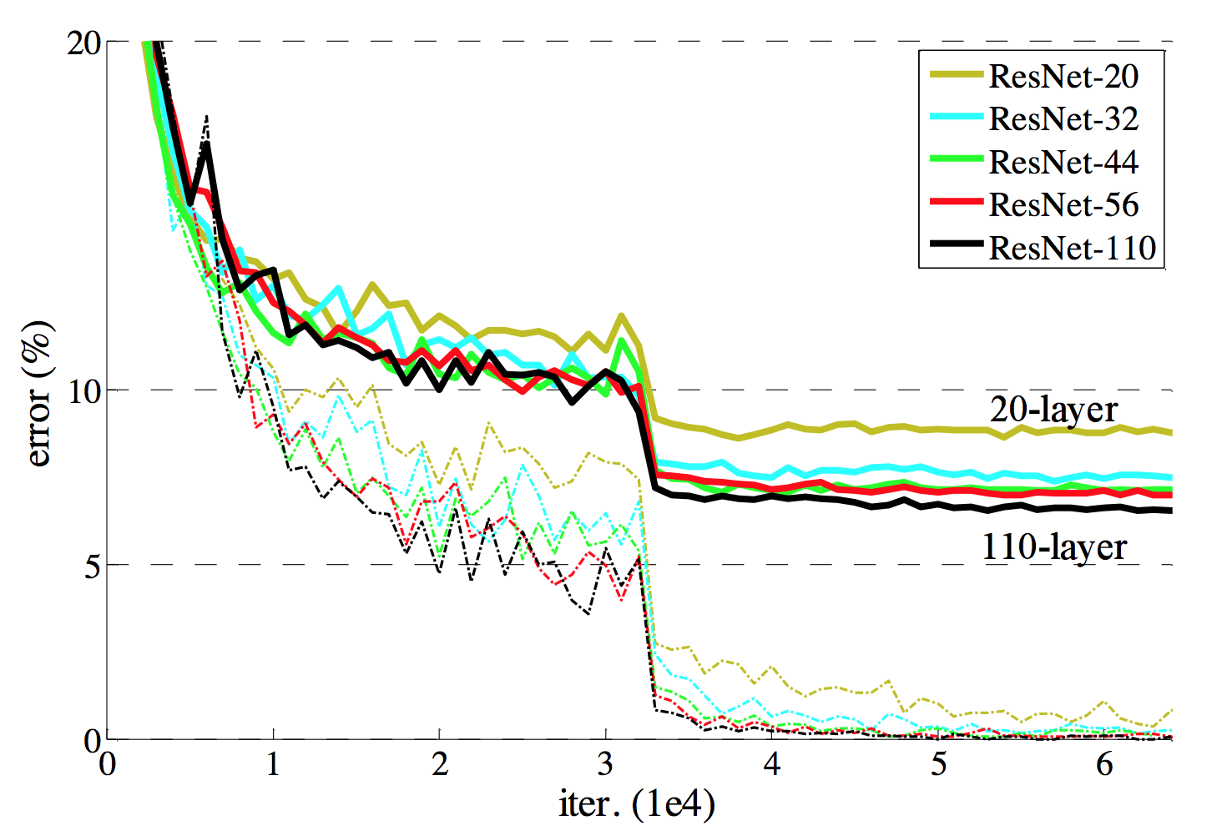
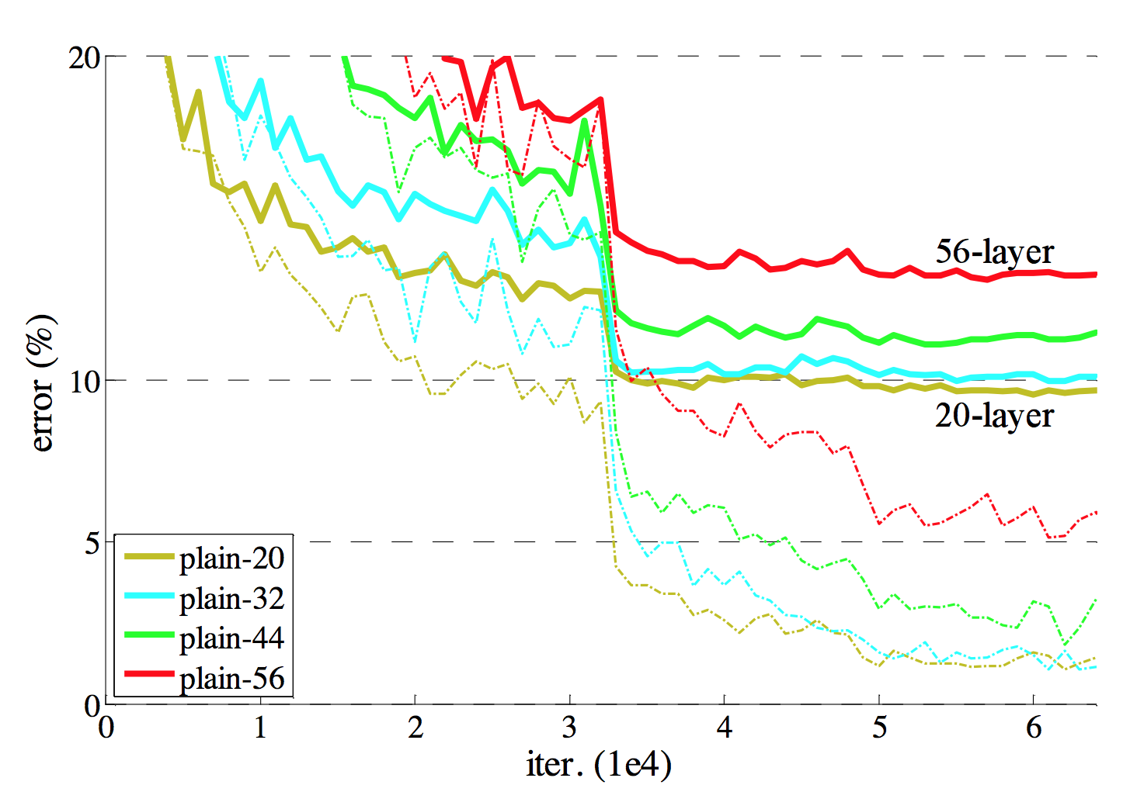
Experimental results

Slide 37
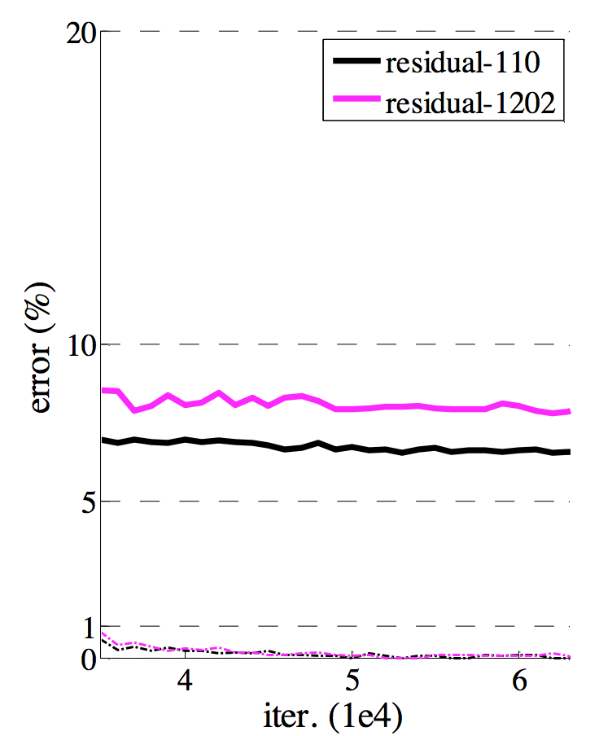
Experimental results

